Slide 1
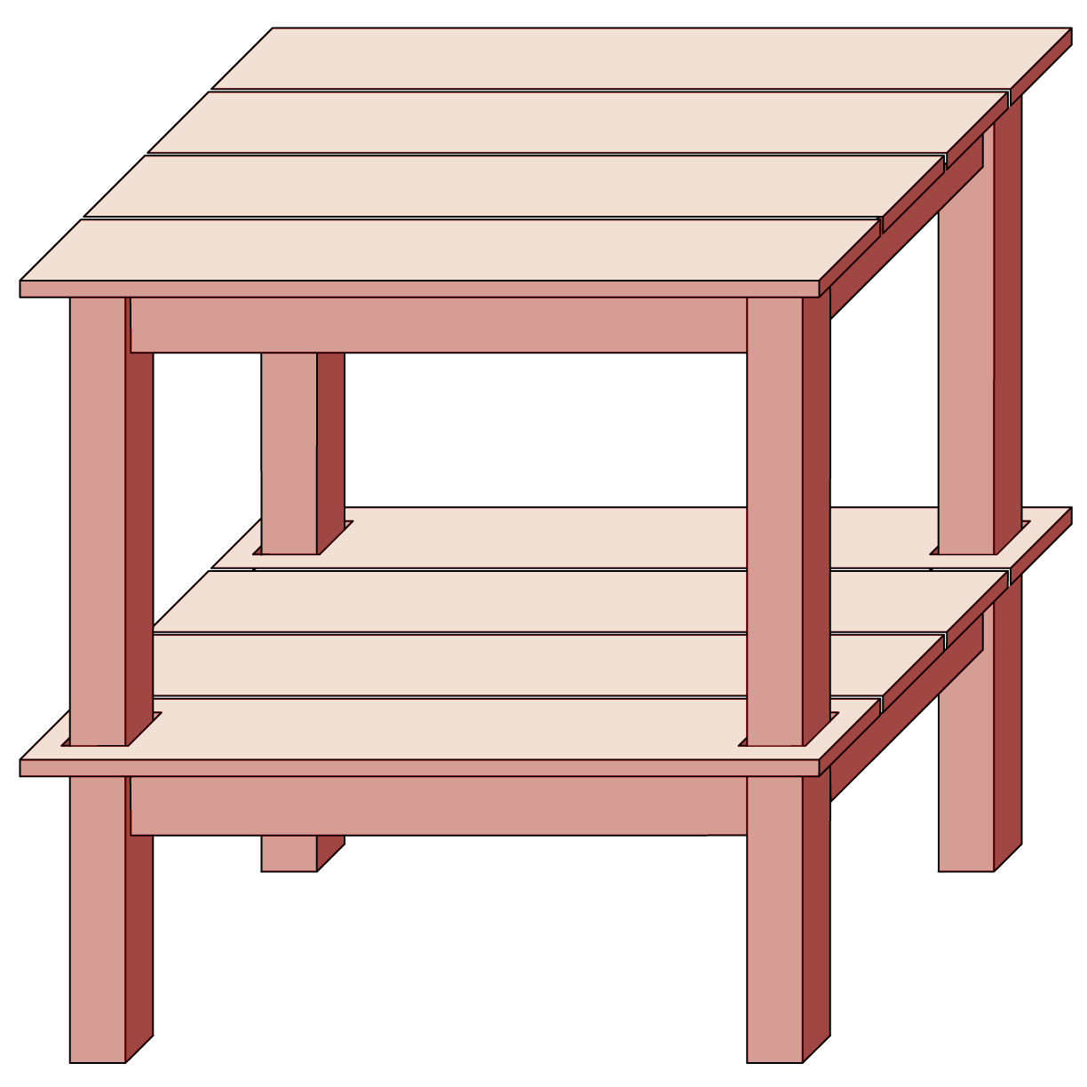
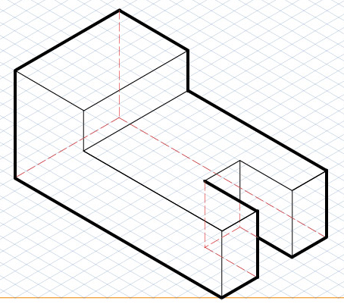
Warm Up
Which drawings are oblique and isometric?

Slide 2
Sketching Irregular Shapes
Sketching and Orthographic Projection

Slide 3
Agenda
Warm Up
Content and Language Objectives
Block Technique
Irregular Shapes
Circles in Projection
Practice
Review Objectives
Questions and Homework

Slide 4
Content Objectives
Be able to sketch irregular shapes using a series of light guidelines.

Slide 5
Language Objectives
Communicate designs via drawings

Slide 6
Block Technique
Replicate a sketch or drawing using a box drawn from light guidelines (erased later)
CLICK

Slide 7
Block Technique
Replicate a sketch or drawing using a box drawn from light guidelines (erased later)
Draw a box around the entire house
13
10
CLICK

Slide 8
Block Technique
Replicate a sketch or drawing using a box drawn from light guidelines (erased later)
Draw a box around the entire house
Draw guidelines for all other vertices (corners), intersections of features
CLICK

Slide 9
Block Technique
Replicate a sketch or drawing using a box drawn from light guidelines (erased later)
Draw a box around the entire house
Draw guidelines for all other vertices (corners), intersections of features
Replicate the guidelines in your notebook using this graph paper as your scale then draw the house
CLICK

Slide 10
Block Technique
Replicate a sketch or drawing using a box drawn from light guidelines (erased later)
Draw a box around the entire house
Draw guidelines for all other vertices (corners), intersections of features
Replicate the guidelines in your notebook using this graph paper as your scale then draw the house
Erase guidelines
CLICK

Slide 11
Irregular Shapes
Replicate irregular shapes using grid method Example: Swimming pools
CLICK

Slide 12
Irregular Shapes
Replicate irregular shapes using grid method Example: Swimming pools
Use underlying graph paper to establish a grid, or make a grid if not on graph paper
CLICK

Slide 13
Irregular Shapes
Replicate irregular shapes using grid method Example: Swimming pools
Use underlying graph paper to establish a grid, or make a grid if not on graph paper
Box in the major shapes with guidelines
12
19
CLICK

Slide 14
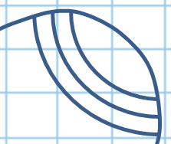
Irregular Shapes
Replicate irregular shapes using grid method Example: Swimming pools
Use underlying graph paper to establish a grid, or make a grid if not on graph paper
Box in the major shapes with guidelines
Analyze blocks of complicated patterns
12
19
CLICK

Slide 15
Circles in Projection
Circles appear as ellipses lying on a face of a cube in isometric views
Ellipse axes align with its face’s diagonals
Must know which plane of isometric view the circles lie on
CLICK

Slide 16
Circles in Projection
Circles appear as ellipses lying on a face of a cube in isometric views
Ellipse axes align with its face’s diagonals
Must know which plane of isometric view the circles lie on
CLICK

Slide 17
Circles in Projection
Circles appear as ellipses lying on a face of a cube in isometric views
Ellipse axes align with its face’s diagonals
Must know which plane of isometric view the circles lie on

Slide 18
Circles in Projection
Start with an isometric cube
CLICK

Slide 19
Circles in Projection
Start with an isometric cube
At each 120º corner draw a line to the center of the opposite side
CLICK

Slide 20
Circles in Projection
Start with an isometric cube
At each 120º corner draw a line to the center of the opposite side
CLICK

Slide 21
Circles in Projection
Start with an isometric cube
At each 120º corner draw a line to the center of the opposite side
CLICK

Slide 22
Circles in Projection
Start with an isometric cube
At each 120º corner draw a line to the center of the opposite side
CLICK

Slide 23
Circles in Projection
Start with an isometric cube
At each 120º corner draw a line to the center of the opposite side
CLICK

Slide 24
Circles in Projection
Start with an isometric cube
At each 120º corner draw a line to the center of the opposite side
DRAW HERE
CLICK

Slide 25
Circles in Projection
Start with an isometric cube
At each 120º corner draw a line to the center of the opposite side
Draw arcs from the center of one edge to the center of the adjacent edges
DRAW HERE
CLICK

Slide 26
Circles in Projection
Start with an isometric cube
At each 120º corner draw a line to the center of the opposite side
Draw arcs from the center of one edge to the center of the adjacent edges

Slide 27
Practice
Given the top and right side views, draw the missing front and left side view.
Scale: 1 block = 5 feet

Slide 28
Practice
Given the multi-view drawing, sketch an isometric drawing of the house
Scale: 1 block = 5 feet

Slide 29
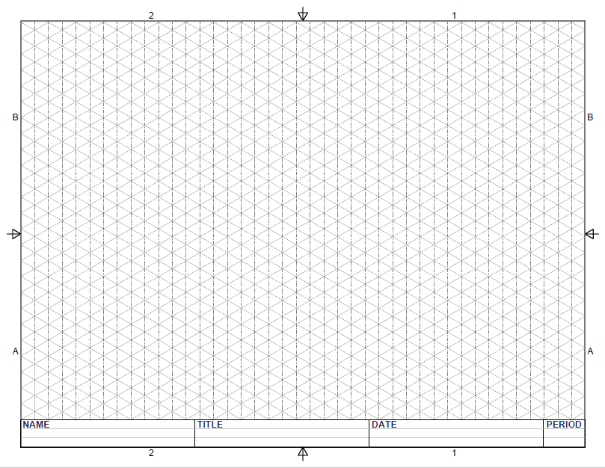
Practice
CLICK
1. First lines – basic shape

Slide 30
Practice
CLICK
2. Guide lines for roof peaks

Slide 31
Practice
CLICK
3. Roof lines

Slide 32
Practice
CLICK
4. That roof

Slide 33
Practice
CLICK
5. Find Intersection

Slide 34
Practice
CLICK
6. Finish Roof

Slide 35
Practice
7. Final Drawing

Slide 36
Content Objectives
Be able to sketch irregular shapes using a series of light guidelines.

Slide 37
Language Objectives
Communicate designs via drawings

Slide 38
Questions

Slide 39
Homework

